Slide 1
MODULE 01: PRINCIPLES AND APPLICATIONS OF TACTICAL COMBAT CASUALTY CARE (TCCC)
TCCC TIER 1
All Service Members
TCCC TIER 2
Combat Lifesaver
TCCC TIER 3
Combat Medic/Corpsman
TCCC TIER 4
Combat Paramedic/Provider

Slide 2




TACTICAL COMBAT CASUALTY CARE (TCCC) ROLE-BASED TRAINING SPECTRUM
ROLE 1 CARE
NONMEDICAL PERSONNEL
MEDICAL PERSONNEL
ASM
CMC
CPP
CLS
YOU ARE HERE
STANDARDIZED JOINT CURRICULUM

Slide 3
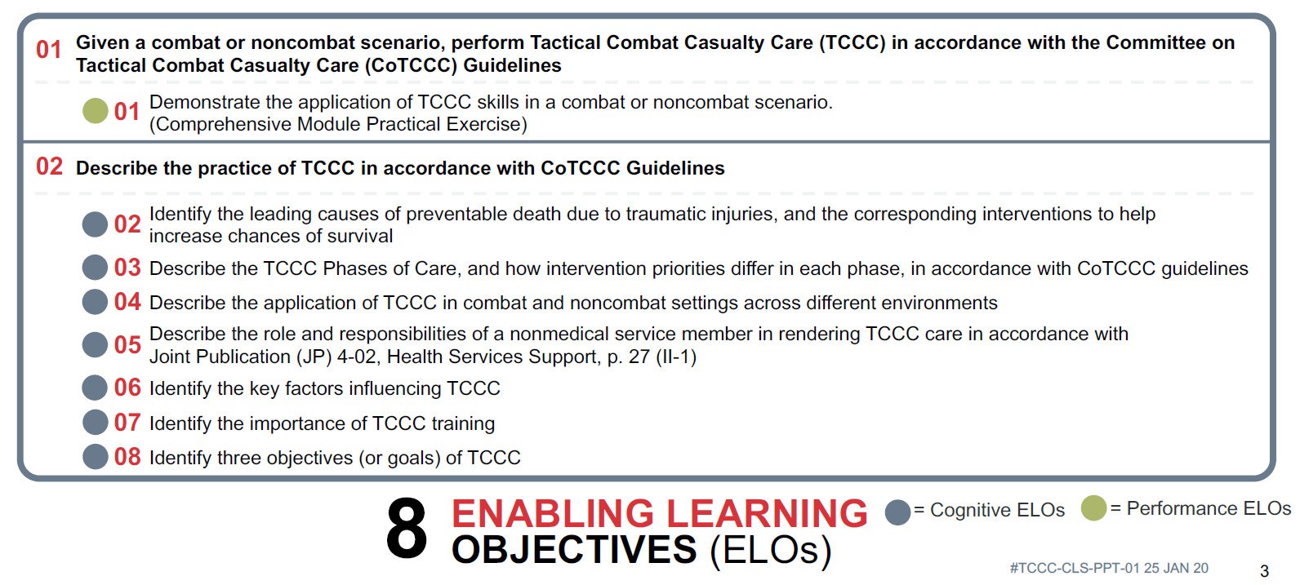






TERMINAL LEARNING OBJECTIVES
PRINCIPLES AND APPLICATIONS OF TCCC
8
ENABLING LEARNING OBJECTIVES (ELOs)
= Cognitive ELOs
= Performance ELOs

Slide 4
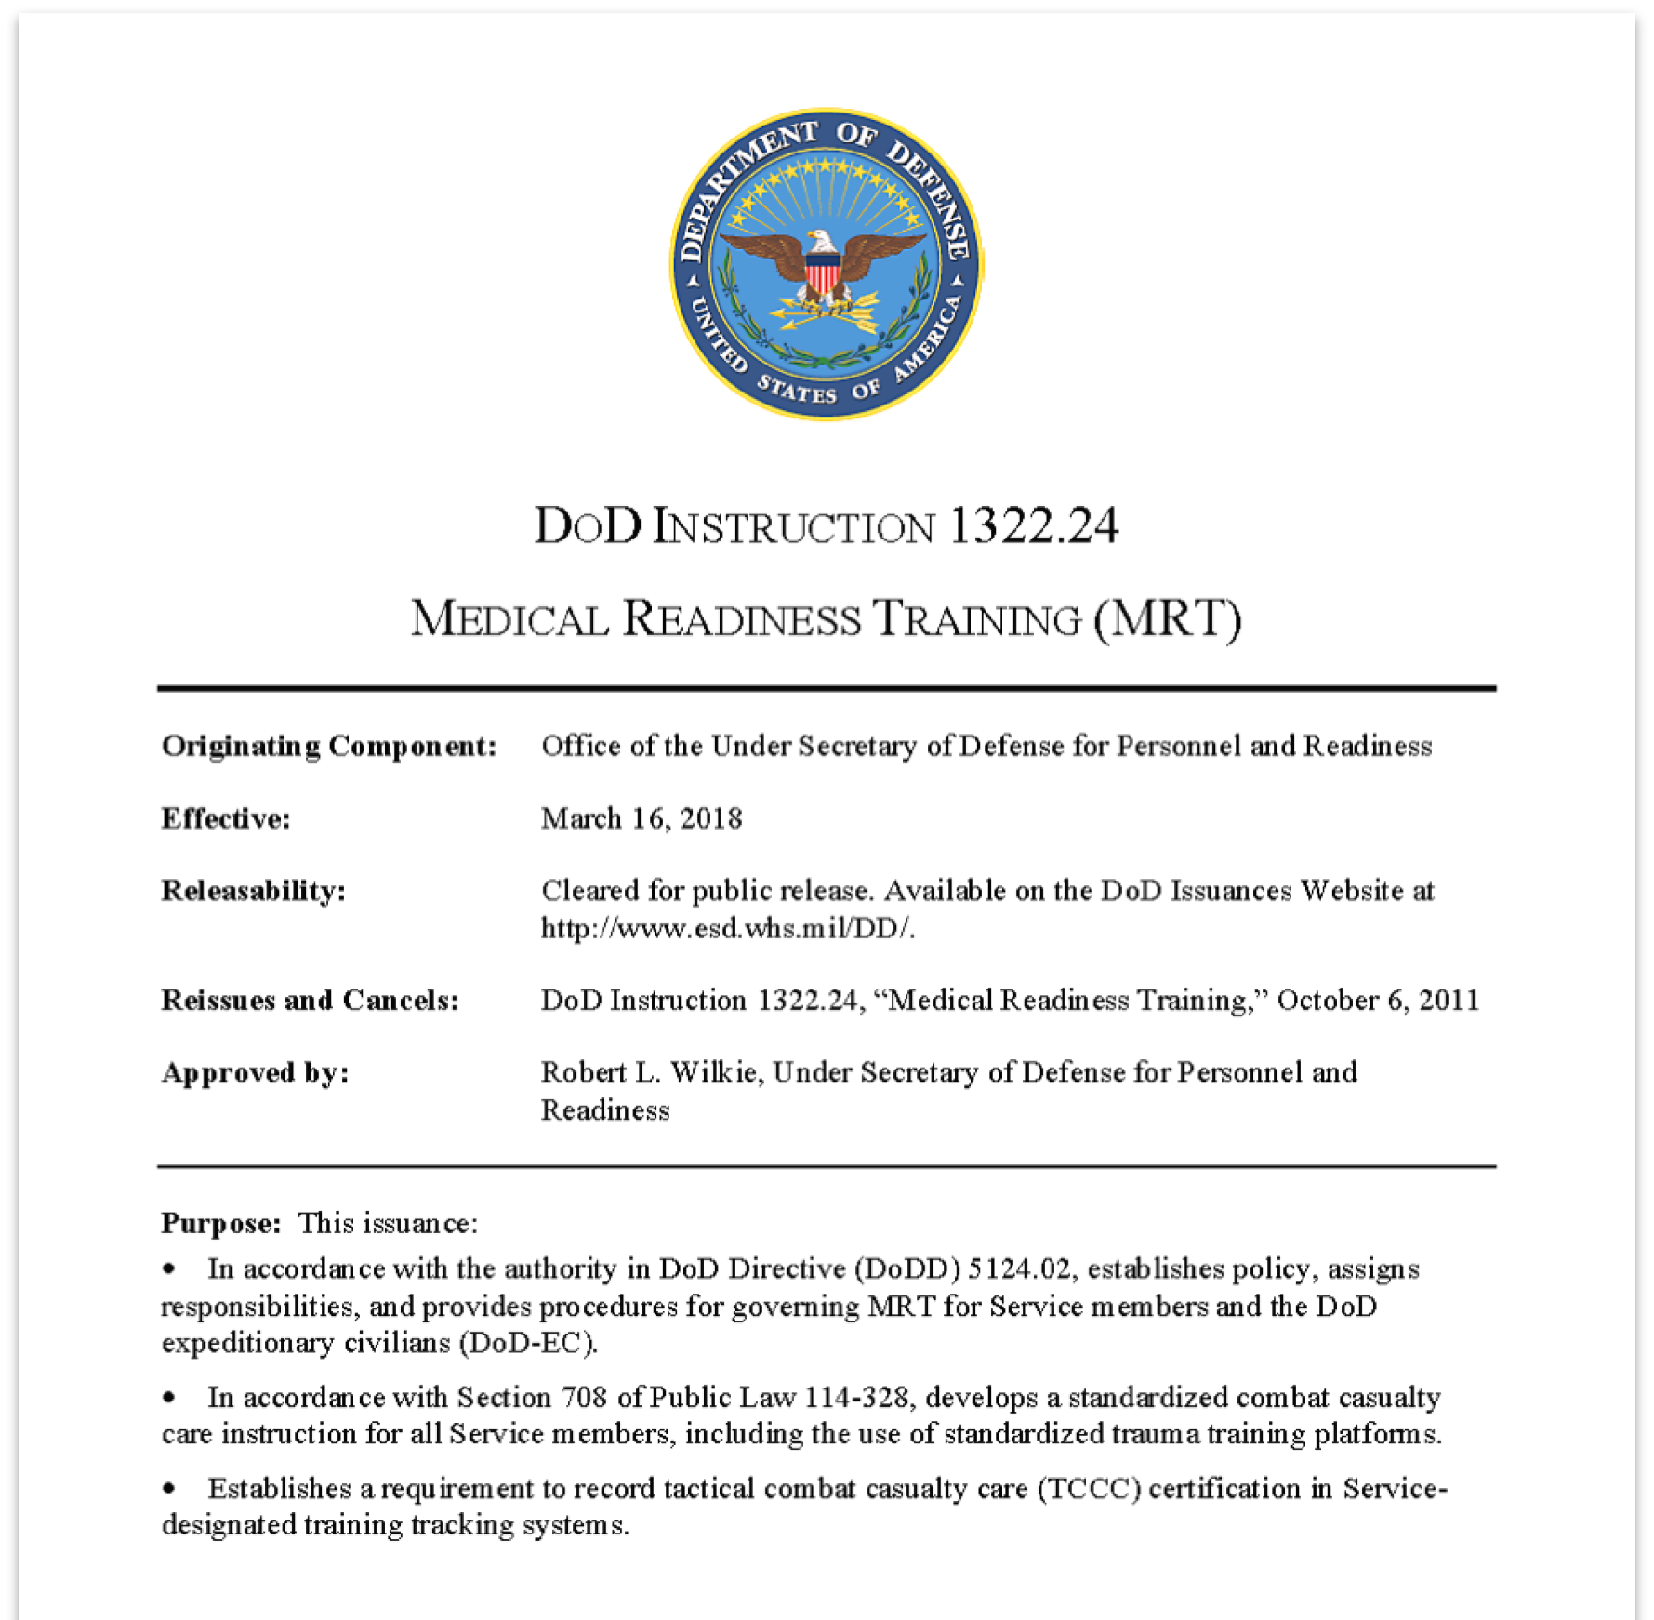
CONGRESSIONAL MANDATE FOR STANDARDIZED TRAINING
DoDI 1322.24
Standardizes Combat Casualty Care for all Service members
Covers the use of standardized trauma training platforms

Slide 5
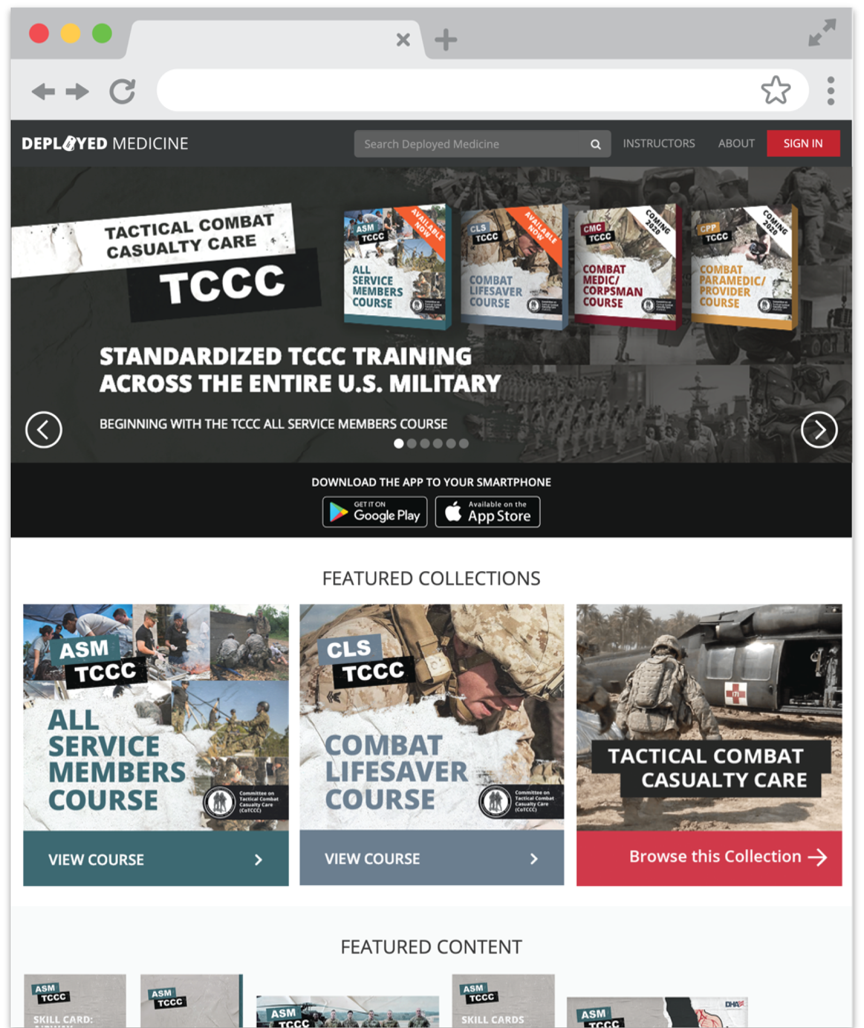
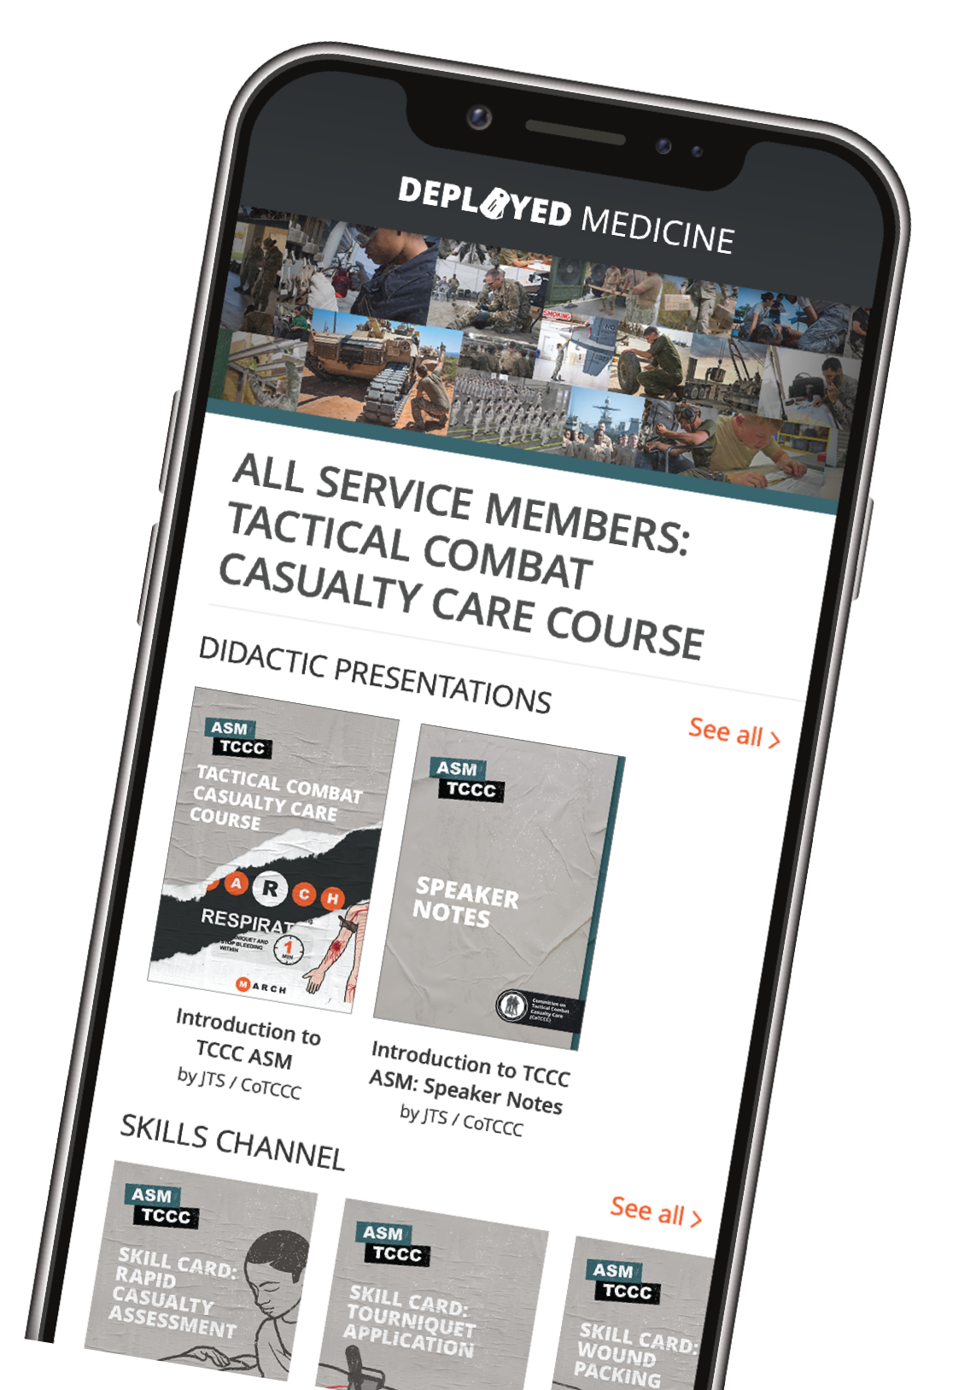



YOUR ONLINE RESOURCE
This is not just your typical first aid training
Training and education resource
ASM TCCC curriculum and resources
Updated videos, podcasts, and resources
Clinical Practice Guidelines (CPGs) downloadable
www.deployedmedicine.com

Slide 6
COURSE CONTENTS
WHAT THIS COURSE CONTAINS
Principles and Applications of TCCC
Medical Equipment
Care Under Fire
Principles and Application of Tactical Field Care
Tactical Trauma Assessment
Massive Hemorrhage Control
Airway Management
Respiration Assessment and Management
Circulation/Hemorrhage Control
Shock Recognition
Hypothermia Prevention
Head Injuries
Eye Injuries
Pain Medication and Antibiotic Administration
Wound Management
Burns
Fractures
Casualty Monitoring
Pre-evacuation Procedures
Evacuation Procedures

Slide 7



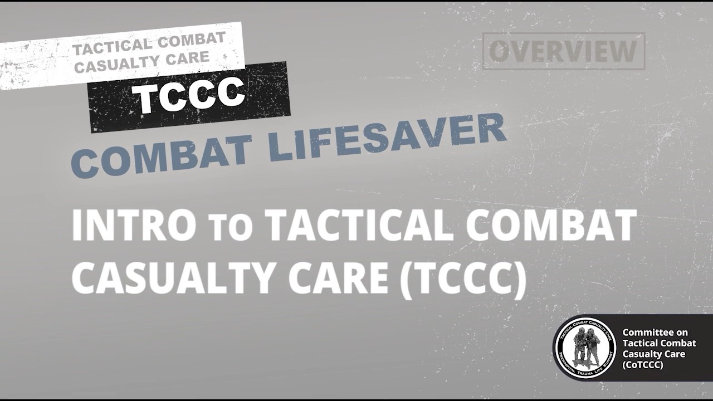
PRINCIPLES AND APPLICATIONS OF TCCC
Video can be found on DeployedMedicine.com

Slide 8

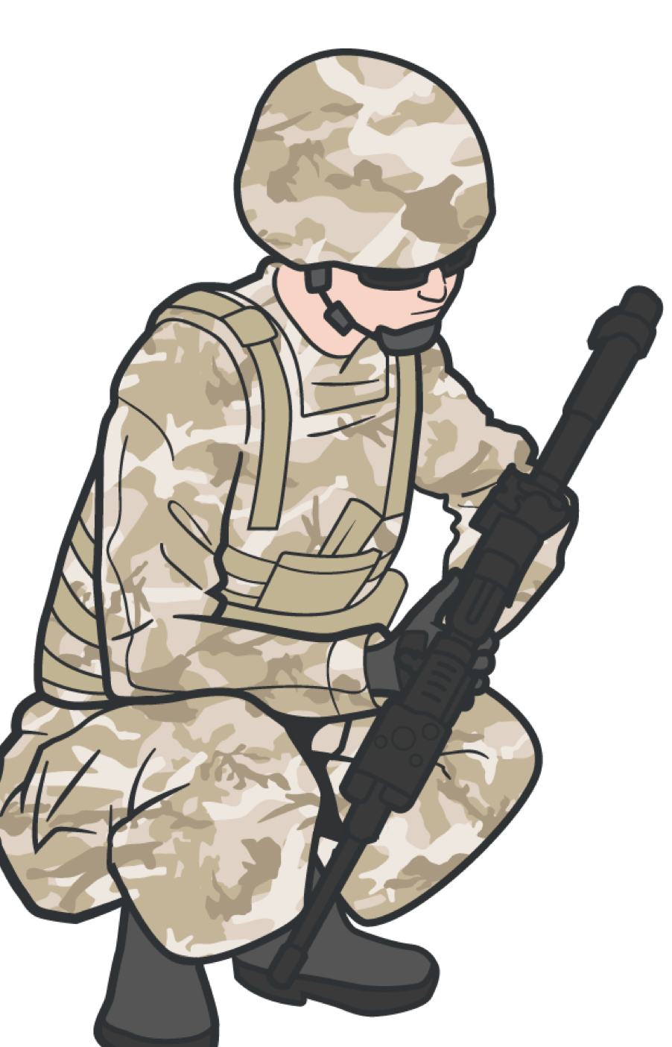
PRINCIPLES AND APPLICATIONS OF TCCC
ROLES AND RESPONSIBILITIES OF THE COMBAT LIFESAVER
In a Care Under Fire situation the CLS:
Must respond to suppression of hostile fire to minimize the risk of injury to personnel and minimize additional injury to previously injured Service members
In Tactical Field Care the CLS Service members:
Must maintain security and situational awareness while continuing to tend to casualties and prepare for evacuation

Slide 9
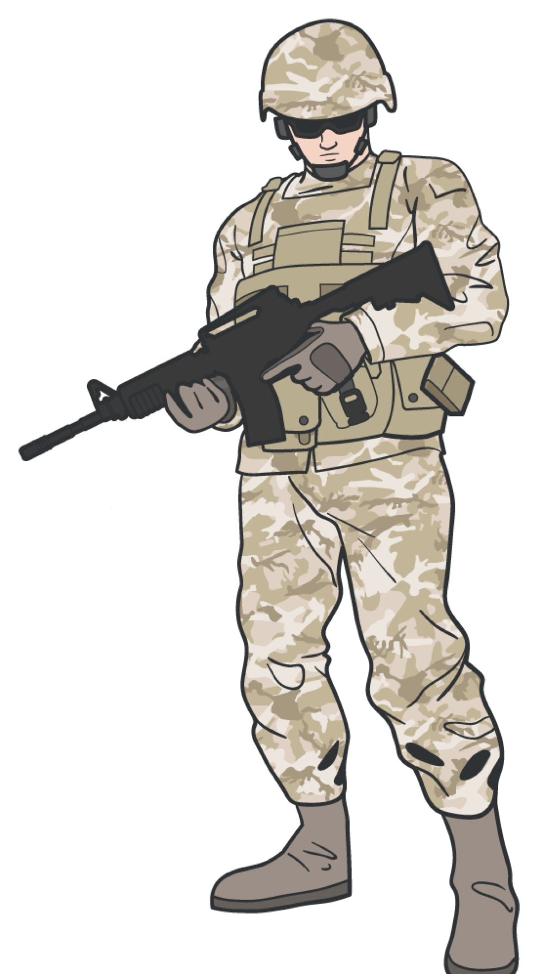

PRINCIPLES AND APPLICATIONS OF TCCC
ROLES AND RESPONSIBILITIES OF CLS
First Responder Care (Role 1)
The first medical care that military personnel receive is provided at Role 1 (also referred to as unit-level medical care or self-aid, buddy aid, combat lifesaver, and/or medic care). This role of care includes:
Immediate lifesaving measures and treatment for disease and non-battle injury (DNBI) or degradation of functional capability sustained by personnel and caused by factors other than those directly attributed to enemy action

Slide 10

THE KEY FACTORS INFLUENCING TCCC
PRINCIPLES AND APPLICATIONS OF TCCC
Hostile fire
Tactical considerations
Environmental considerations
Wounding patterns
Equipment constraints
Delays in reaching higher levels of care
Level of first responder training and experience

Slide 11
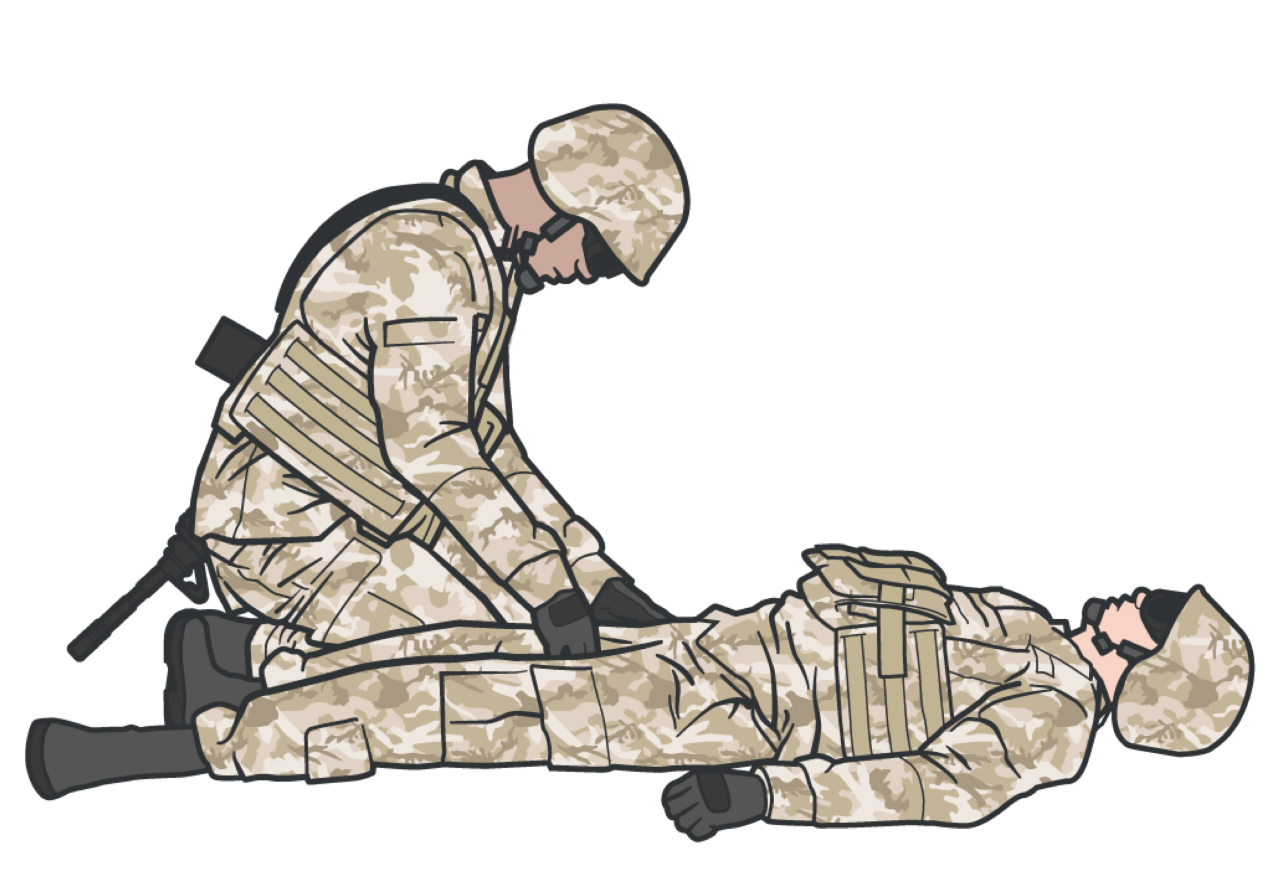
PRINCIPLES AND APPLICATIONS OF TCCC
IMPORTANCE OF TCCC TRAINING
TCCC focuses on identifying and treating the causes of preventable death on the battlefield
Bleeding from arm and leg injuries
Junctional bleeding where an arm or leg joins the torso such as the groin
Noncompressible bleeding such as a gunshot wound to the abdomen
Tension pneumothorax (air trapped in the chest that prevents breathing and circulation), and airway problems

Slide 12
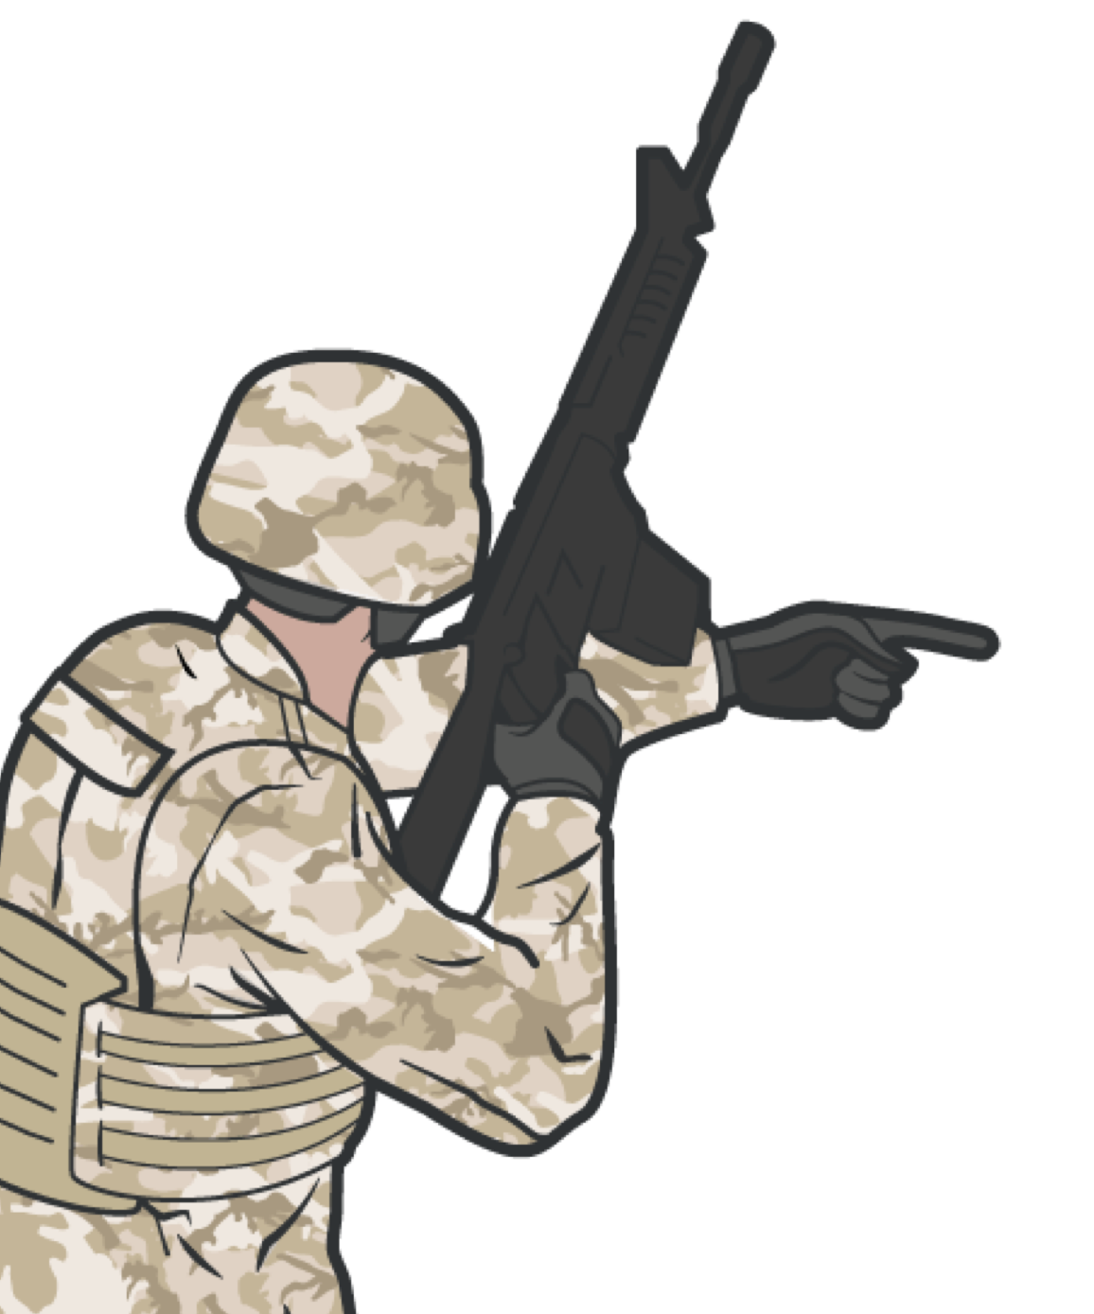

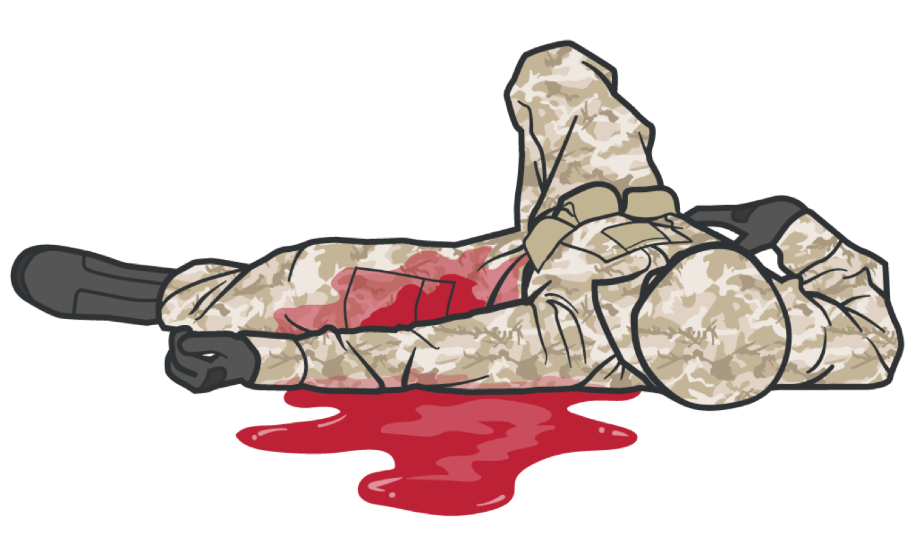


PRINCIPLES AND APPLICATIONS OF TCCC
THREE GOALS OF TCCC
Treat the casualty
Prevent additional casualties Complete the mission

Slide 13




ENTER THE BATTLEFIELD

Slide 14

Three PHASES of TCCC
1
CARE UNDER FIRE
RETURN FIRE AND TAKE COVER
TACTICAL FIELD CARE
COVER AND CONCEALMENT
TACTICAL EVACUATION CARE (TACEVAC)
More deliberate assessment and treatment of unrecognized
life-threatening injuries
2
3
Quick decision-making:
Basic Management Plan:
Consider scene safety
Identify and control life- threatening bleeding
Move casualty to safety
Maintain tactical situational awareness
Triage casualties as required
MARCH PAWS assessment
Pre-evacuation procedures
Continuation of documentation
NOTE: This is covered in more advanced TCCC training!

Slide 15


CARE UNDER FIRE
PHASE 1: CARE UNDER FIRE
RETURN FIRE AND TAKE COVER
DIRECT CASUALTY TO REMAIN ENGAGED
GAIN FIRE SUPERIORITY
APPLY SELF-AID
AND MOVE TO COVER
(if able)
MOVE TO CASUALTY
(if casualty is unable to move to cover)
Never attempt to rescue a casualty until
hostile fire is suppressed
Using available resources, ensure scene safety

Slide 16


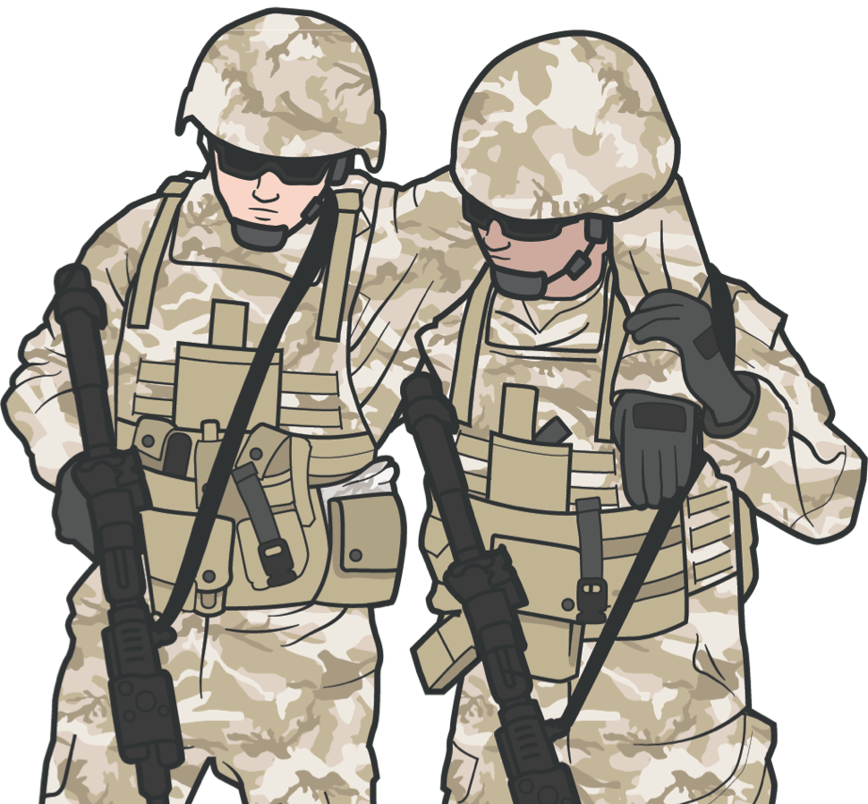
CARE UNDER FIRE
PHASE 1: CARE UNDER FIRE
APPLY TOURNIQUET TO CONTROL
LIFE-THREATENING
BLEEDING
CONTINUE TO MAINTAIN FIRE SUPERIORITY
IMPORTANT CONSIDERATIONS:
Continuously assess risks and make a plan before moving a casualty
MOVE CASUALTY
For life-threatening bleeding, place a tourniquet "high and tight" above the wound

Slide 17
MARCH PAWS
TACTICAL FIELD CARE
DURING LIFE-THREATENING
AFTER LIFE-THREATENING
M A R C H
MASSIVE BLEEDING
#1 Priority
P
PAIN
AIRWAY
A
ANTIBIOTICS
RESPIRATION (Breathing)
W
WOUNDS
CIRCULATION
S
SPLINTING
HYPOTHERMIA / HEAD INJURIES

Slide 18

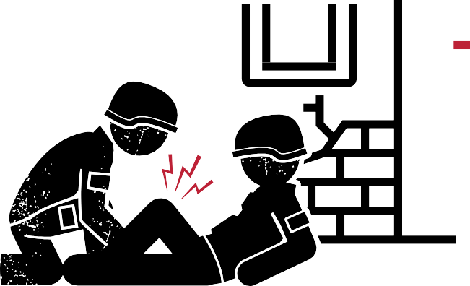
PHASE 2: OTHER CONSIDERATIONS OF TACTICAL FIELD CARE
TACTICAL FIELD CARE
REMEMBER:
Always use the casualty’s Joint First Aid Kit (JFAK) first
TFC can turn into a CUF situation unexpectedly
Personnel should maintain their situational awareness
TFC
The casualty and the person rendering care are not under direct fire
Intervention priorities should follow MARCH PAWS
LIMITED SUPPLIES
Medical equipment and supplies are limited to what is carried into the field by the combat lifesaver and the individual Service member

Slide 19

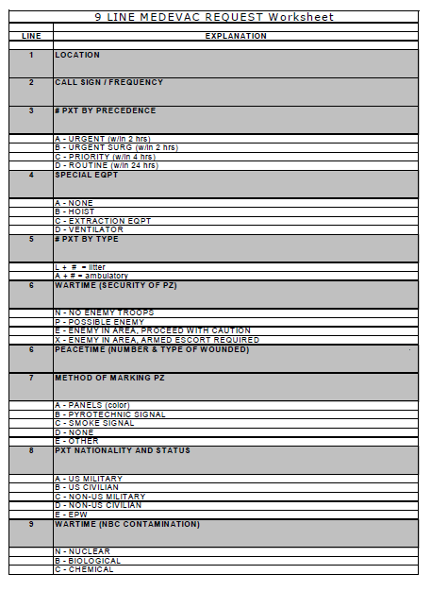

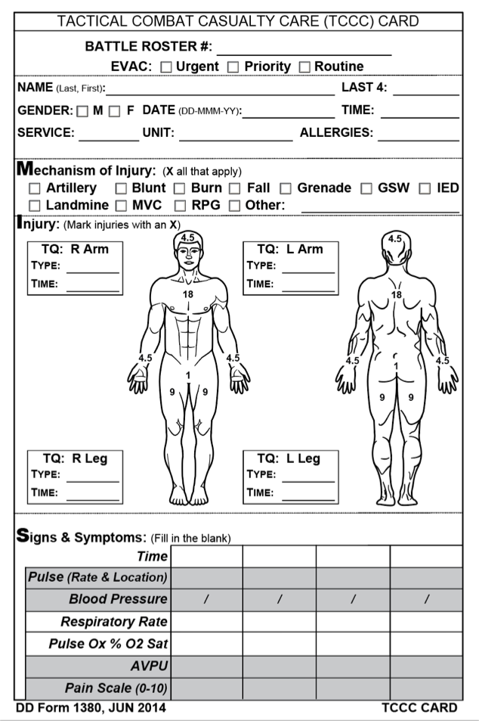

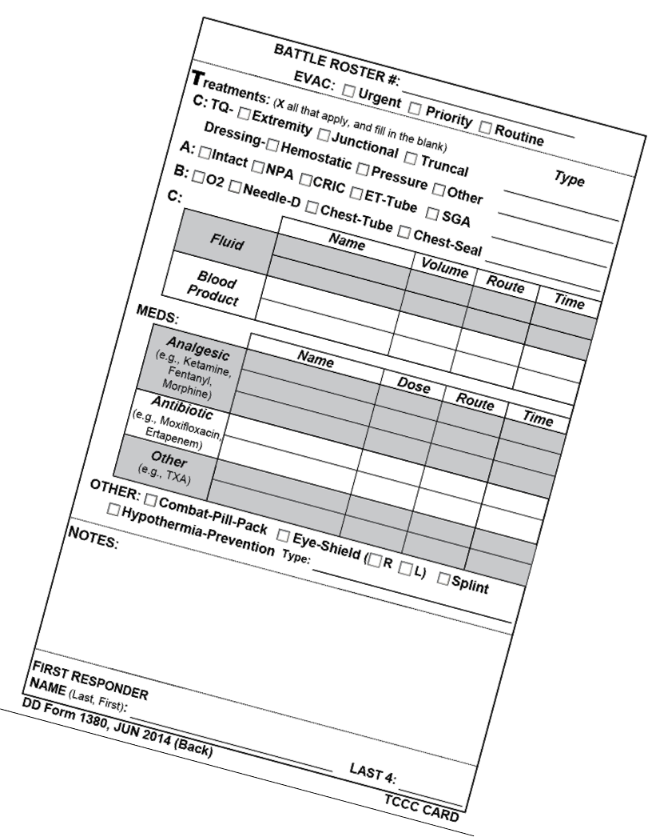



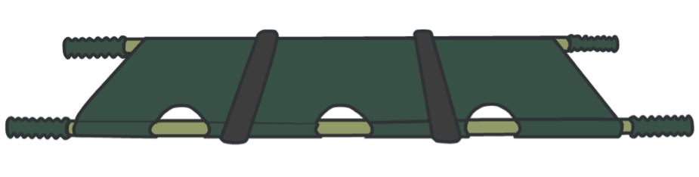
TACTICAL EVACUATION
PHASE 3: TACTICAL EVACUATION CARE
COMPLETE REPORT
CASUALTY MONITORING PRE-EVAC PROCEDURES
Continue to reassess and monitor casualty
M Mechanism of injury
I Injuries
Symptoms
Treatment
Complete DD Form 1380
EVAC REQUEST
Use 9-Line Format
CASUALTY PREP
Prep Litter
Prep Evac Equipment Pack Casualty Secure Items
(litter transport)

Slide 20
GOALS
IN SUMMARY
Prevent additional casualties Complete the mission
Three PHASES of TCCC
Treat the casualty
1
CUF
RETURN FIRE AND TAKE COVER
2
TFC
COVER AND CONCEALMENT
3
TACEVAC
Quick decision-making:
More deliberate assessment and treatment of unrecognized
life-threatening injuries:
Consider scene safety
Identify and control life- threatening bleeding
Move casualty to safety
Basic management plan:
Maintain tactical situational awareness
Triage casualties as required
Conduct MARCH PAWS
assessment
Pre-evacuation procedures
Continuation of documentation

Slide 21
CHECK ON LEARNING
What factors influence TCCC?
What are the phases of care in TCCC?
What is the most essential treatment task in CUF? What is every first responder’s role in CUF?
What does MARCH PAWS stand for?

Slide 22
ANY QUESTIONS?

